Slide 1

Air Travel Demand Through 2025:
Recovery and Factors Influencing Long-term Growth
Amar Mann
Transportation Economist
Energy Information Administration
March 2003

Slide 2
Introduction
National Energy Modeling System (NEMS) Overview
Factors Influencing Air-Travel demand
  Population and Economic Growth
  Fuel Prices and Aircraft Efficiency
  Constraints
Air-Travel Projections Through 2025
Conclusions

Slide 3
Overview of NEMS
National Energy Modeling System
Oil and Gas
Supply
Module
Macroeconomic
Activity
Module
International
Energy
Module
Residential
Demand
Module
Natural Gas
Transmission and
Distribution
Module
Commercial
Demand
Module
Integrating
Module
Coal
Market
Module
Transportation
Demand
Module
Renewable
Fuels
Module
Electricity
Market
Module
Petroleum
Market
Module
Industrial
Demand
Module
Supply Components
Conversion Components
Demand Components

Slide 4
Factors Influencing Air Travel Demand
Macroeconomic Factors
  GDP
  Disposable Personal Income
  Merchandise Exports
Other Factors
  Jet Fuel Prices
  Energy Efficiency
  Ticket Price
  Infrastructure Constraints (airspace, runways, etc)
Other Factors Not Modeled
  Consumer Behavior
  Electronic Communication/Teleconferencing

Slide 5
Estimating Air Travel Demand
Air Travel Module Forecasts:
  Yield (Revenue/Passenger)
  Revenue Passenger-Miles (RPM)
    Domestic (Personal, Business)
    International
  Revenue Ton-Miles (RTM)
  Total Seat-Miles

Slide 6
Factors Influencing Energy Efficiency
Load Factors
Technologies
  Ultra-High Bypass Engines
  Thermodynamics
  Advanced Aerodynamics
  Weight-reducing Materials
Aircraft Sales, Stocks and Retirement Rates

Slide 7
Capacity Constraints
Capacity definition
Plans to Expand Capacity
Data for Individual Airports aggregated to develop Capacity Constraint

Slide 8
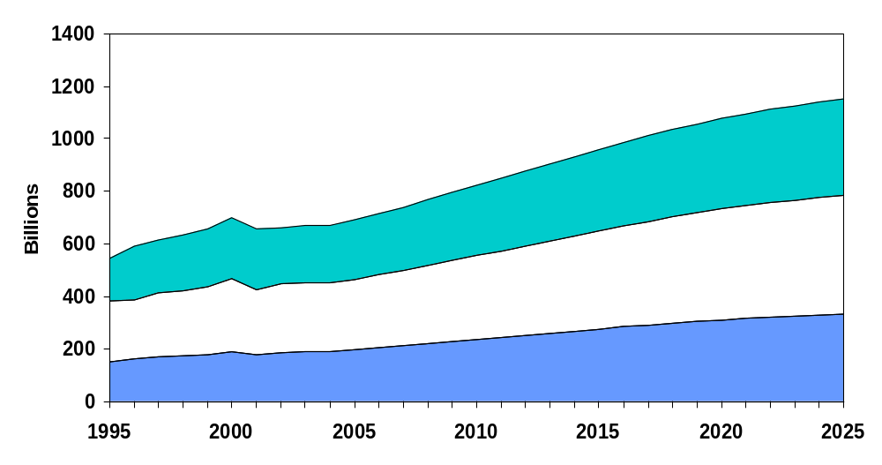
Projected Revenue Passenger Miles
Business (1.8%)
Domestic (2.2%)
Personal (2.4%)
International (2.6%)
Notes:
Growth Rates:

Slide 9
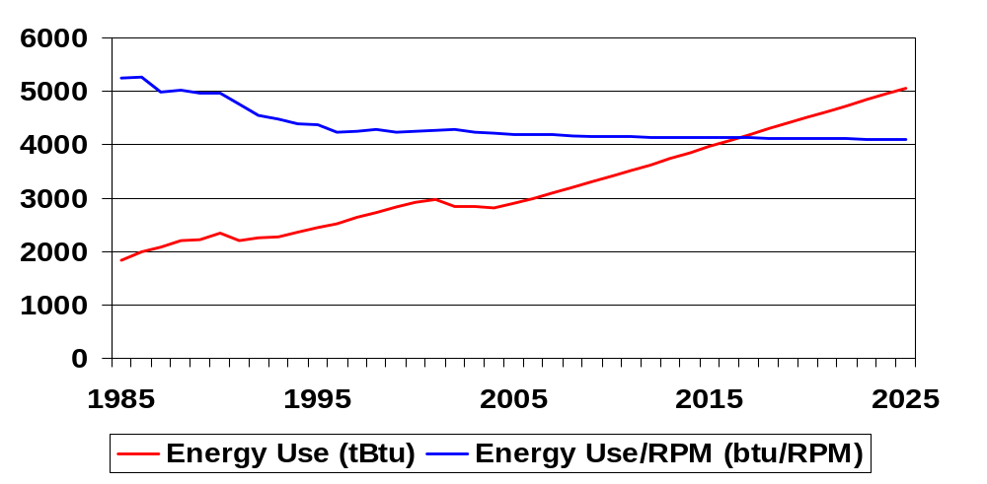
Energy Use and Energy Efficiency
Notes:
Growth Rates:
Load Factors and Technologies driving Energy Use Lower than RPM’s

Slide 10
Uncertainties Influencing Future Demand
Airline Restructuring
Economic Growth and Timing of Recovery
Technological/Operational Efficiency
Increased Use of Regional Jets
Security Costs and Measures
Potential Consequence of a War Against Iraq

Slide 11
Model Enhancements for AEO ‘04
Analyze Growth in Market Segments
Re-examine Technology Attributes and Investigate Future Technologies
Impacts of Proposed Legislation (Regulating Aircraft Noise and Emissions)

Slide 12
Conclusion
Air Travel Is a Major Area of Growth in Long-Term Transportation Energy Demand
Recovery of Air-Travel Demand Expected in 2005 or 2006
Airport Congestion Will Again Be a Factor Following Recovery

